Slide 1


PANIMALAR ENGINEERING COLLEGE
Department of Computer Science and Engineering
Project Review
SECUREBYTE - AN APP FOR WEB PENTESTING
Project Guide: Dr.S.Balaji, B.Tech,M.E,Ph.D,
Associate Professor
Team Members:
Dineshkumar.A 211417104055
Immanuel Sanjay.J 211417104087
Jeeva.V 211417104095
Batch Number:E8

Slide 2
Abstract
This application combines various types of web pentesting tools which perform various operations on particular targets in a single application.It generates the report of particular operations then we can analyse the generated report.The Personalized reports will be saved as report file in a text format.The report will be sent to an Prior-organization to alert them about their application or websites vulnerabilities and the system weaknesses. And the Organization may get aware about the reports and will immediately fix the loophole of the particular application or website

Slide 3
Literature Survey
Wang, S., Wang, J., Feng, C., & Pan, Z. (2016).
They can analyze the vulnerabilities and types of attacks on WLAN which is specified as IEEE 802.11 standard. The IEEE 802.11 WAN is a wireless network which uses radio waves to transfer the data.
So, it is most susceptible to the security issues like WPE/WPA/WPA2 cracking, Denial of Service (DoS), and rogue access points. By siht, a ylisae rekcatta eht csecse eht srefsnart ,atad evitisnes eht s sllawerif eht ssapyb dna ,stekcap eht tpecretni . ,stekcap suoicilamThe penetrating testing ensures the security of the wireless networks.
F ot ,oslA . loot gnitidua eht sa desu si SPDIAW ,skcatta sseleriw eht gnitceted ro,NALW eht gnitcetorp rof dna sksir eht etagitim the desu si noisurtni sseleriw. WAIDPS is an open-source wireless Swiss-Knife which works on Linux and is written in Python.

Slide 4
Goel, J. N., & Mehtre, B. (2015).
They can used Vulnerability Assessment and Penetration Testing (VAPT) for cyber defense.eser siht nIar,hc the nefed rebyc eht rof dezylana si TPAV eht fo ecnamrofrepse ygolonhcet to provide the proactive cyber defense.
It helps in founding the vulnerabilities in advance for preventing the attacker from compromising a system. eser sihT ar eht debircsed hcPrevalent Vulnerability assessment techniques and VAPT tools.
The VAPT process is step by step process that consists of 9 phases in its life cycle. The results of the research shown that VAPT is a useful technique for Cyber defense technology.

Slide 5
B L V Vinay Kumar, K Raja Kumar, & V. Santhi (2016).
They investigated different Penetration testing tools using Kali Linux. This research helped to understand how to perform the different penetration tests using private networks, virtualized tools, and systems.
t lla tceted ot desu saw gnitset noitartenep ehThe skcatta l gniffins ciffart eki. kcatta elddiM-eht-ni- naM dnaF ces dna sisylana krowten retupmoc eht rou dna pacrettE ,gnitidua ytir desu si euqinhcet tentfirD.
The implementation also used the Wireshark for traffic sniffing. The results demonstrated that the proposed technique for penetration testing could be used successfully in real time environment.

Slide 6
Fiocca, M. (2009).
He presented an introduction of Penetration testing to address the vulnerability of computer systems.
This paper included a literature survey of Penetration testing which is performed by security experts to find the vulnerabilities of the system.
This study mainly presented the two main types of penetration testing. These testing are black box testing and white box testing.

Slide 7
Salas, M., & Martins, E. (2014).
They proposed a technique for security testing which used the two techniques in order to detect the XSS attacks against the web services. The two techniques are Fault Injection and Penetrating Testing.
XSS is a cross-site scripting attack on Web services which raises new security challenges.
This type of testing technique is used to identify the sender by combining the security tokens and WSS (WS- Security).
It also ensures the authorized access to SOAP messages communication.
Another injection tool that was used is WSInject which introduces the faults or errors on Web Services for checking the environment behavior.

Slide 8
T. Refaat, T. Abdelhamid and A. Mahmoud Mohamed (2016).
They presented a security solution for WLANs in order to achieve the standard network security requirements having low cost and stability. The proposed security solution works on two levels.
These levels are Radio Frequency (RF) and the frame security. This solution is unique from the other as it works in the two WLAN security levels.
The proposed solution provides the required frame security by incorporating AES encryption, and conjunction with 802.1x authentication Freeradius server for WLANs.

Slide 9
Technology Stack
SOFTWARE
Python 3
Windows 7/8.1/10
Visual Studio Code
Various python modules
HARDWARE
2 GB RAM/512 GB HDD
i3/i5/i7 Processor, 2.4 GHz
Wifi Module
Monitor 14/15 color

Slide 10
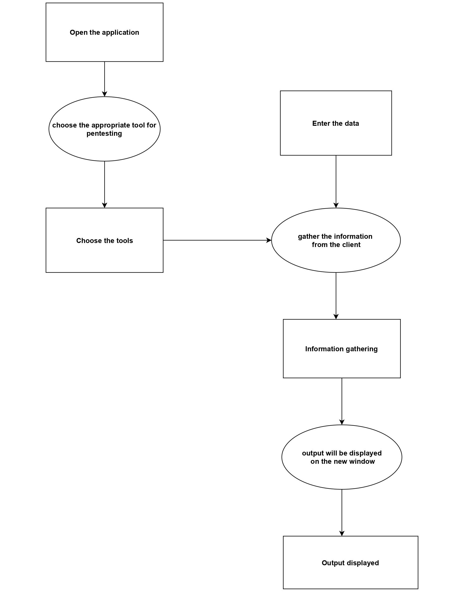
System Architecture

Slide 11
Implementation of the Algorithms
SYSTEM MODULE
The SecureByte contains three modules functions namely:
Pentest tools
Other tools
Report
MODULES EXPLANATION
Pentest tools
Pentest tools allow you to quickly discover and report vulnerabilities in websites,applications and network infrastructures. It provides a set of powerful and tightly integrated pentesting tools which enable you to perform easier, faster and more effective pentest engagements.These Pentest tool perform individual operations such as port scanner, dns scanner, sql scanner, directory scanner, xss scanner.

Slide 12
Other tools
Other tools are different from the pentest tools and the operation performed is also different. The other tools are hash creator, brute hash, zip file cracker,password brute forcing, system directory scanner.
Report
The report is an account or statement describing in detail an event, situation, or the like, usually as the result of observation, inquiry, etc.Here the detailed output of the each scanners will be stored as an docx file. This docx file will be retrieved through the prior directory in the file explorer for the future use.

Slide 13
ALGORITHM
Make sure the Internet must be turned on for the entire session of the program
Open the Application -> SecureByte.exe
By clicking on the pentest tools drop-down box different types of scanner that perform various functions and select one of them to perform operations.
Port scanner
Subdomain scanner
Sql Scanner
Directory Scanner
XSS scanner
On the other side the other tools drop-down box contains some another type of tools
Brute Hash
Hash creator
Password brute forcing
System directory scanner
Zipfile cracker

Slide 14
Output will be displayed on the current screen and also it will be saved as a text file.
The text file will be used as a report that can be to the prior-organization .
The report section contains the recent outputs that were previously generated.
Port Scanner
A port scan is a method for determining which ports on a network are open. As ports on a computer are the place where information is sent and received. Running a port scan on a network or server reveals which ports are open and listening (receiving information), as well as revealing the presence of security devices such as firewalls that are present between the sender and the target. This technique is known as fingerprinting. It is also valuable for testing network security and the strength of the system’s firewall.

Slide 15
XSS Scanner
Cross-Site Scripting (XSS) is one of the most well known web application vulnerabilities. ... Test for XSS: For each page discovered in the previous step, the scanner will try to detect if the parameters are vulnerable to Cross-Site Scripting and report them in the results page.
Directory Brute Forcing
Brute force directory guessing attacks are very common attacks used against websites and web servers. They are used to find hidden and often forgotten directories on a site to try to compromise.
Subdomain Scanner
The Subdomain Scanner is a subdomain discovery tool. It allows you to run a scan for a top-level domain name to discover target organization subdomains configured in its hierarchy.

Slide 16
SQL Scanner
A SQL injection scanner is an automated tool used to verify the vulnerability of websites and web apps for potential SQL injection attacks. During a SQL injection attack, the hacker attempts to illegally retrieve stored database information like usernames, passwords, etc. SQL injection scanners test the websites and web apps to check whether they are prone to SQL injection attacks.
Hash Creator
The MD5 hashing algorithm is a one-way cryptographic function that accepts a message of any length as input and returns as output a fixed-length digest value to be used for authenticating the original message.This tool is used to create a hash output for the given input string
Brute Hash
Brute force is also used to crack the hash and guess a password from a given hash. In this, the hash is generated from random passwords and This tool is used to give the original string for the hashed input string.

Slide 17
System directory
The Directory Scanner allows you to scan a certain directory on the file system for files containing XML messages. Once the messages have been read, they can be passed into the core message pipeline where the full collection of message processing filters can act on them. It shows the directories present in a particular system.
Password brute forcing
In cryptanalysis and computer security, password brute forcing is the process of recovering passwords from data that has been stored in or transmitted by a computer system in scrambled form. This tool shows how much time it takes to crack a password using brute forcing
Zip file cracker
ZIP password cracker is software that you use for recovering passwords of encrypted archive files.This tool is used to crack password protected zipfiles.

Slide 18
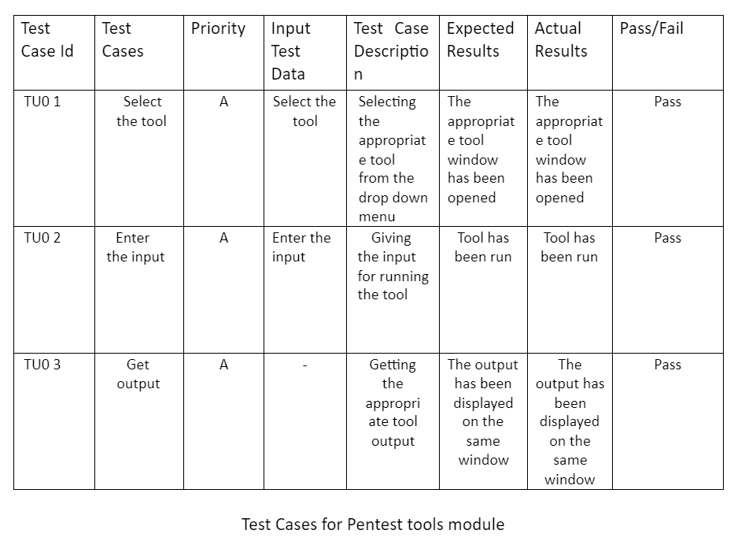
Testing/Performance Analysis

Slide 19
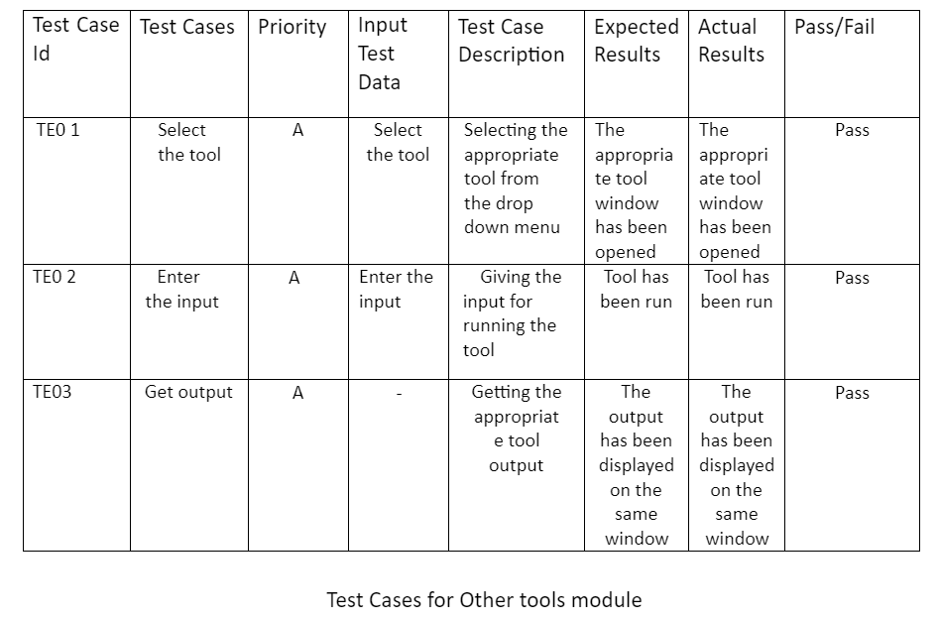

Slide 20
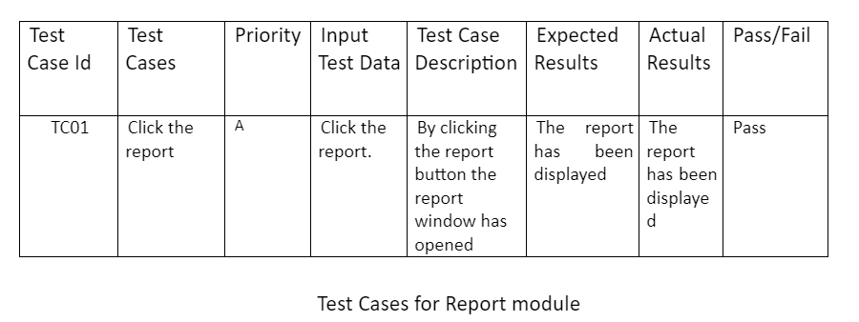

Slide 21
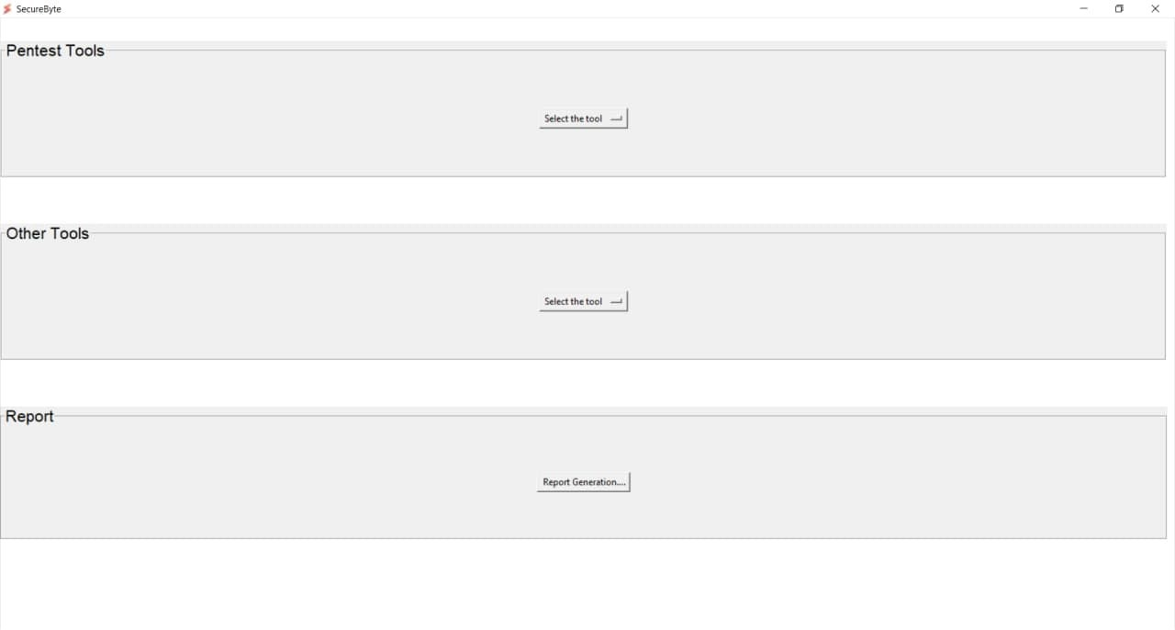
Screenshots
SecureByte Main Window

Slide 22
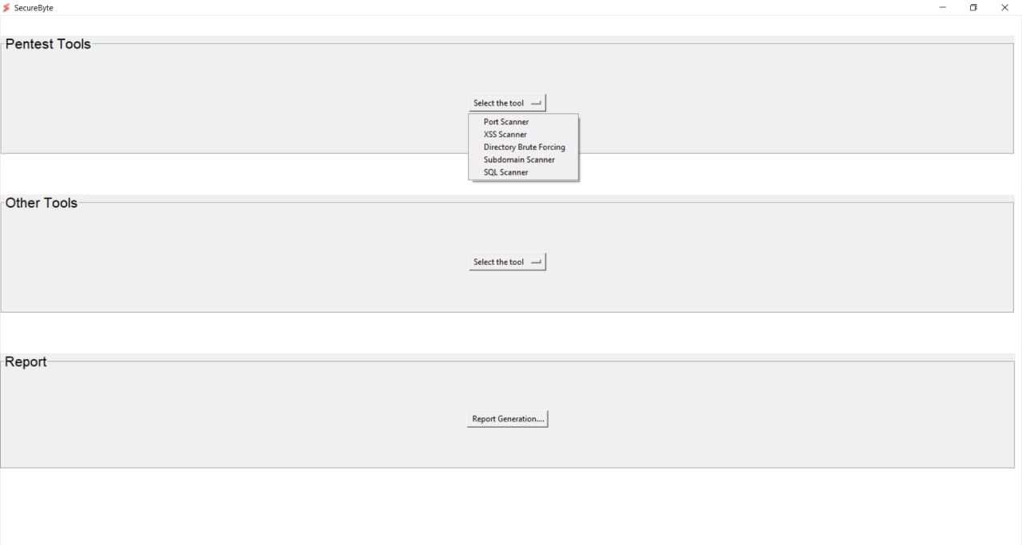
Select The Tool

Slide 23

Port Scanner Tool

Slide 24
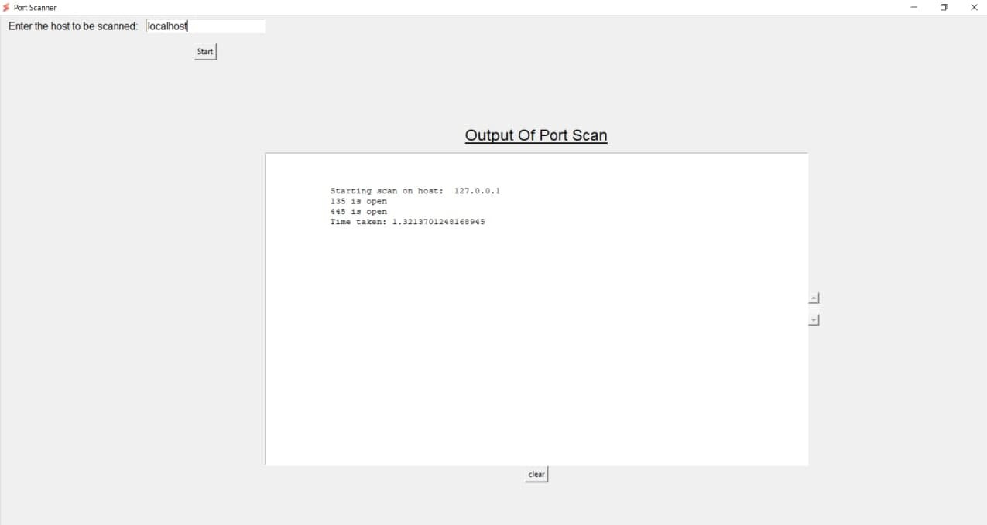
Port Scanner Output

Slide 25

XSS Scanner Tool

Slide 26
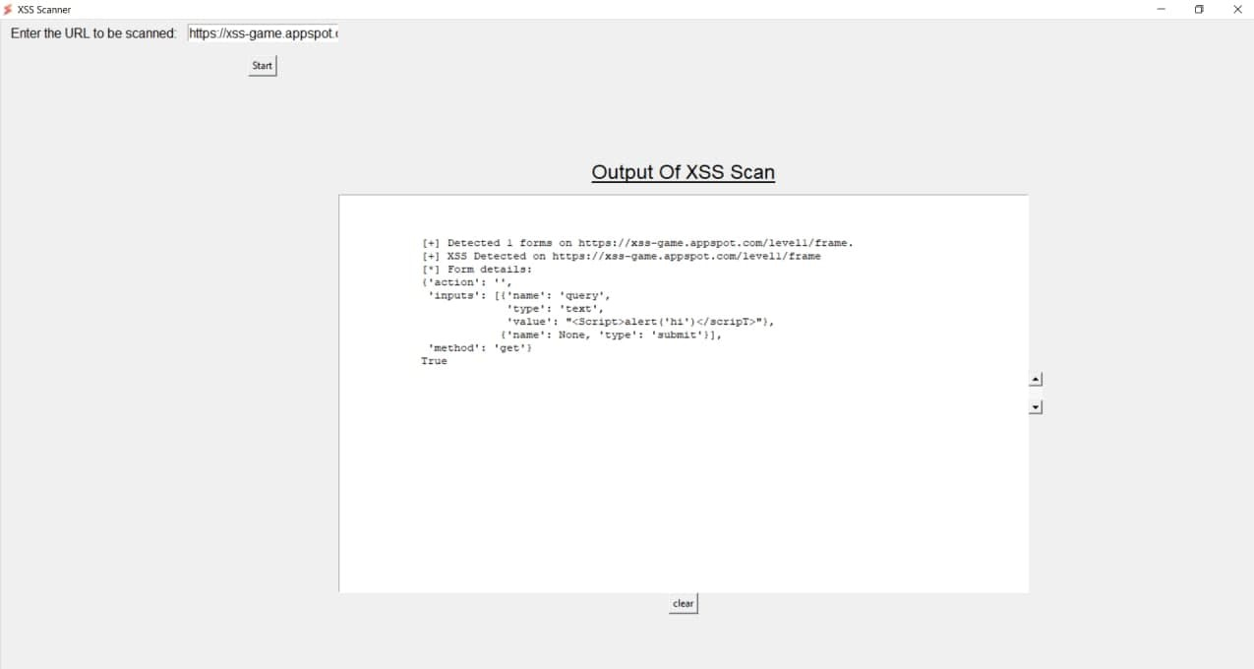
XSS Scanner Output

Slide 27
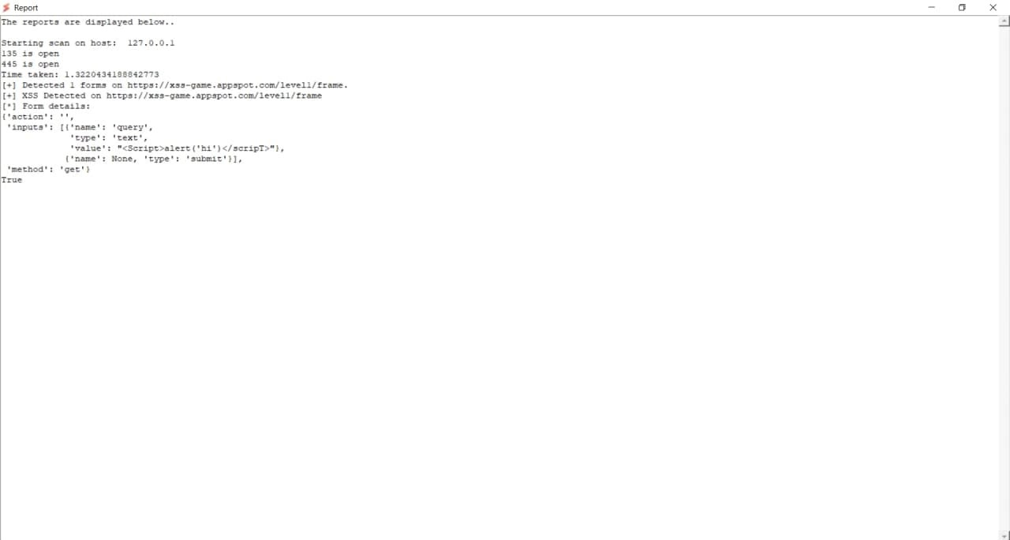
Full Report

Slide 28
Conclusion and Future Enhancement
CONCLUSION
The objectives of this work is to offer a fast, reliable and automated testing tool, which is also easier to use than existing tools. It contains almost all the needed tools for pentesting so it makes the process simple. It is an application so we can add as many tools as we can. It is portable, stable and reliable. Minimal configuration required. Quickly discover the attack surface of a target organization. Speed-up your pentesting engagements.
FUTURE ENHANCEMENT
We have created the second version of this application. In that application we have changed the UI and also we have reduce the number of files. So this application is easy to use and its lightweight. The work is under progress.

Slide 29
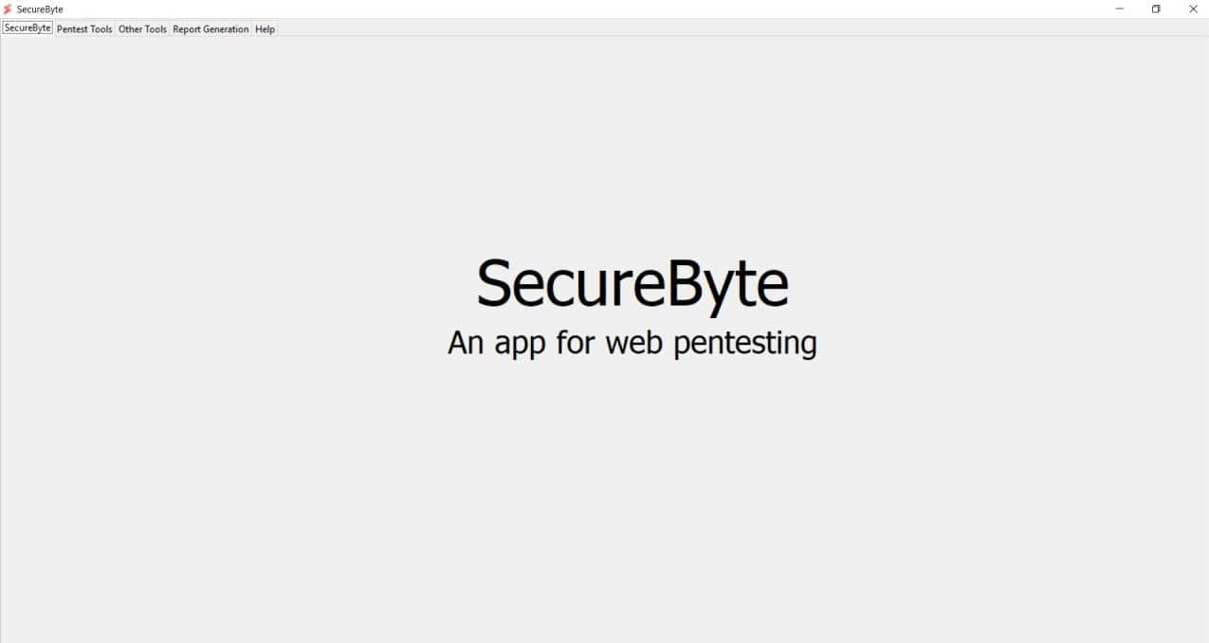
SecureByte 2.0
Welcome screen

Slide 30
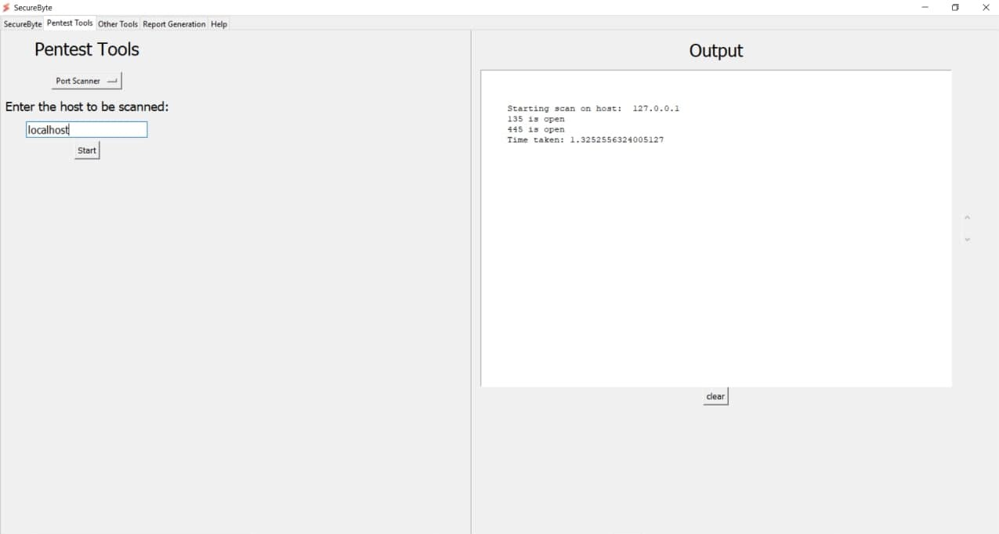
Port Scanner Input and output

Slide 31
References
Mei, J. (2009). An approach for SQL injection vulner-ability detection. In Proceedings of the SixthInternational Conference on InformationTechnology.
M. Khari, Sonam, Vaishali And M. Kumar, "Comprehensive Study Of Web Application Attacks And Classification," 2016 3rd International Conference On Computing For Sustainable Global Development (Indiacom), New Delhi, 2016, Pp. 2159-2164.
Jose Fonseca, Marco Vieira, And Henrique Madeira, "Evaluation Of Web Security Mechanisms Using Vulnerability & Attack Injection", Dependable And Secure Computing, Ieee Transactions (Volume:11, Issue: 5)
https://simplysecure.blog/2017/07/05/FIVE-PHASES-OFPENETRATION-TESTING
Sanfilippo, S. “Hping – Active Network Security Tool,” http://www.hping.org/, accessed on Nov. 23, 2011.

Slide 32
K. Nirmal, B. Janet And R. Kumar, "Web Application Vulnerabilities - The Hacker's Treasure," 2018 International Conference On Inventive Research In Computing Applications (Icirca), Coimbatore, India, 2018, Pp. 58-62.
Padmaja K,"A Study On Web Application And Protection Against Vulnerability", In International Journal Of Engineering Research And Application, (Ijera),2012, Pp.001-006.
"Security Code Review-Identifying Web Vulnerabilities", By Kiran Maraju.
M.Khari And N.Kumar, "User Authentication Method Against Sql Injection Attack", International Journal Of Scientific And Engineering Research,2013, Pp. 1649-1653.
https://Hackernoon.Com/Timing-Based-Blind-Sql-AttacksBd276dc618dd
Guo, F., Yu, Y., & Chiueh, T. (2005). Automated and safe vulnerability assessment. In Proceedings of the 21st Annual Computer Security Applications Conference.

